Slide 1


HS 2015
Current Trends in Distributed Systems
Apache Storm
Group:
Patrick Zumsteg
Simon Wallny
Philipp Oldenburg

Slide 2
Contents
Basics
  The Cluster
  ZooKeeper
  Topologies
    Spouts&Bolts
    Arranging Tasks
  Storm vs. Competition
Application
  Languages
  Spouts & Bolts
  Topologies
    Example: Word Count
Demo
HS 2015
Current Trends in Distributed Systems – Apache Storm

Slide 3
What is Storm?
Framework for distributed data stream processing
  Aims to optimally distribute tasks among nodes
Used for continuous in-/out-streams
Very resilient
  „dead“ nodes easily restarted, jobs reassigned
Still in beta phase
HS 2015
Current Trends in Distributed Systems – Apache Storm

Slide 4
How does it work?
Cluster of nodes
  1 master node
  Multiple worker nodes
Each node runs a daemon
  Nimbus (master node)
  Supervisor (worker nodes)
Node != physical device
  Multiple nodes per device
HS 2015
Current Trends in Distributed Systems – Apache Storm

Slide 5
The Storm Cluster
Nimbus:
  Assigns Tasks to Supervisors
  Distributes code
  Reacts to dead workers
Supervisor:
  „mindless“ worker
  Runs worker process(es)
  Based on orders from Nimbus
Nimbus can't single-handedly control all workers
  Helpers: the ZooKeepers
HS 2015
Current Trends in Distributed Systems – Apache Storm

Slide 6
Between master and slave: the ZooKeeper
Apache ZooKeeper
  Node(s) in the cluster
Similarities to a file system
  Hierarchical data structure
  Every node contains data
  Data kept in memory → small files (metadata)
  High throughput; optimized for large DS
Client connects to ZooKeeper-server
  State information of Supervisors via heartbeat
  Nimbus makes decisions based on ZK information
Downside: bigger ZK-cluster → slow write-requests
  Write-requests passed to all ZK-nodes
HS 2015
Current Trends in Distributed Systems – Apache Storm

Slide 7
Storm Topologies
Topology: the job which the cluster carries out
Primary building block: the Task
  Spout continuously outputs data
  Bolt processes (and outputs) data
HS 2015
Current Trends in Distributed Systems – Apache Storm

Slide 8
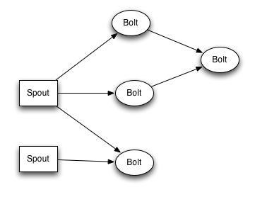
Spouts and Bolts
HS 2015
Current Trends in Distributed Systems – Apache Storm

Slide 9
Storm Topology: Arranging Tasks
Tasks are grouped in Executor-Threads
  Rule of thumb: one Task per Executor
Executors grouped into Working Processes
Nimbus assigns WP to Supervisor nodes
  Also evenly distributes Executors among WP
  Tries to optimize load balance
  If worker node dies: WP is now „free“, reassigned
No direct control over assignment to WP (and to physical devices)
HS 2015
Current Trends in Distributed Systems – Apache Storm

Slide 10
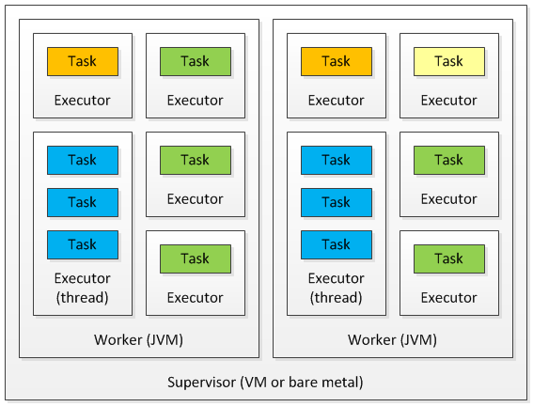
Storm Topology: Arranging Tasks
HS 2015
Current Trends in Distributed Systems – Apache Storm

Slide 11
Storm vs. Competition
Hadoop: MapReduce job instead of Topology
  MR processes batch of data, then terminates
  Topology processes data stream indefinitely
Spark: also tailored towards batch processing
  Like Hadoop, but much faster due to in-memory data storage
  Streaming: Spark chops stream up into batches
  Storm processes stream directly
HS 2015
Current Trends in Distributed Systems – Apache Storm

Slide 12

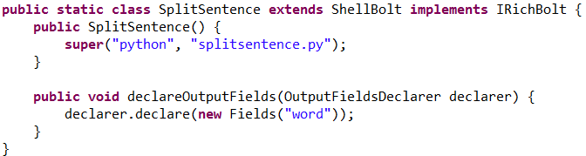



Languages
HS 2015
Current Trends in Distributed Systems – Apache Storm

Slide 13


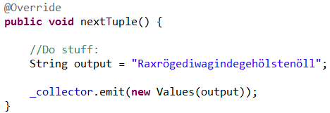
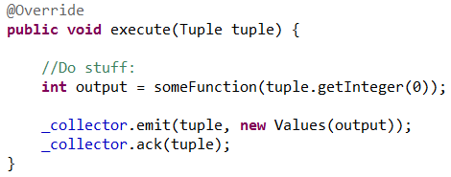
Spouts & Bolts
Spout: Bolt:
HS 2015
Current Trends in Distributed Systems – Apache Storm

Slide 14
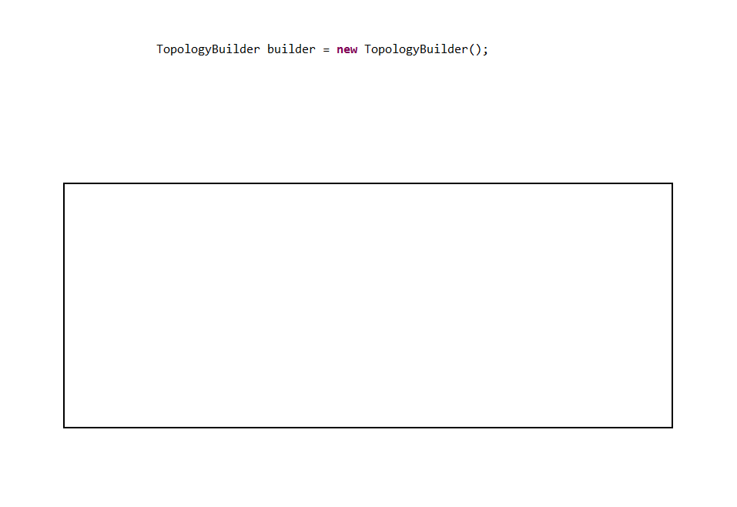
Example – Count Words
HS 2015
Current Trends in Distributed Systems – Apache Storm

Slide 15
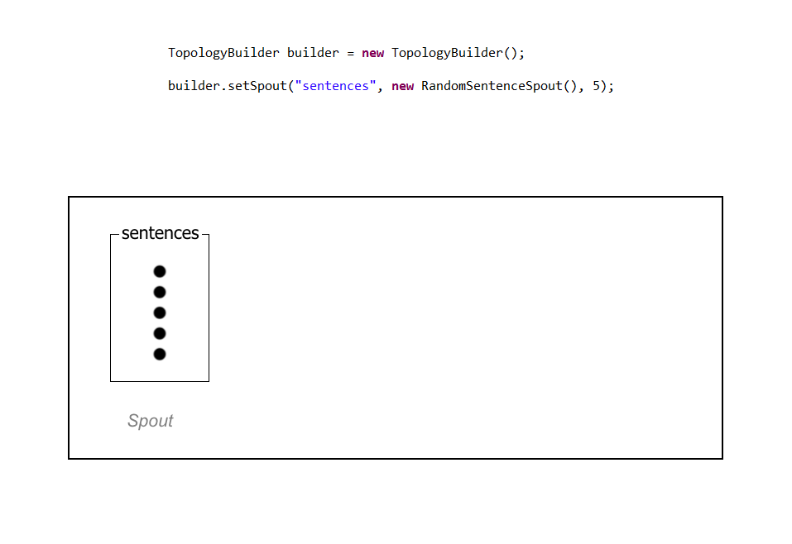
Example – Count Words
HS 2015
Current Trends in Distributed Systems – Apache Storm

Slide 16
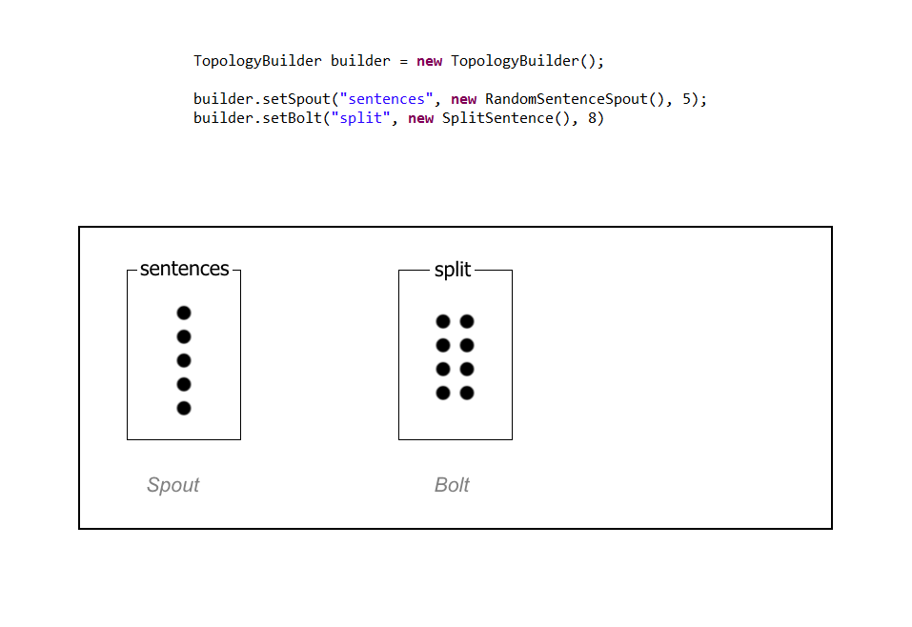
Example – Count Words
HS 2015
Current Trends in Distributed Systems – Apache Storm

Slide 17
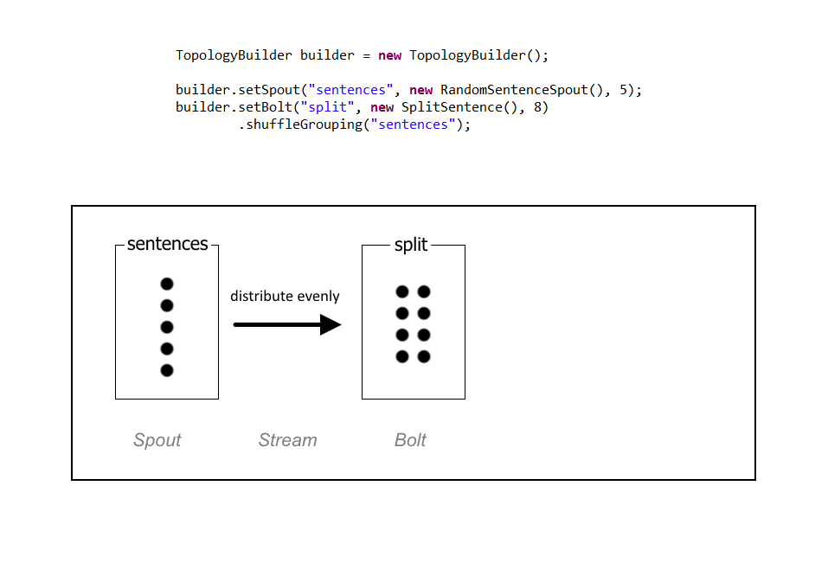
Example – Count Words
HS 2015
Current Trends in Distributed Systems – Apache Storm

Slide 18
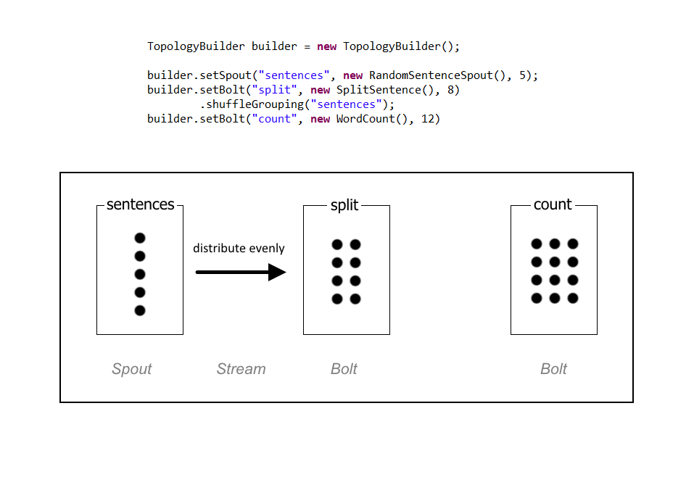
Example – Count Words
HS 2015
Current Trends in Distributed Systems – Apache Storm

Slide 19
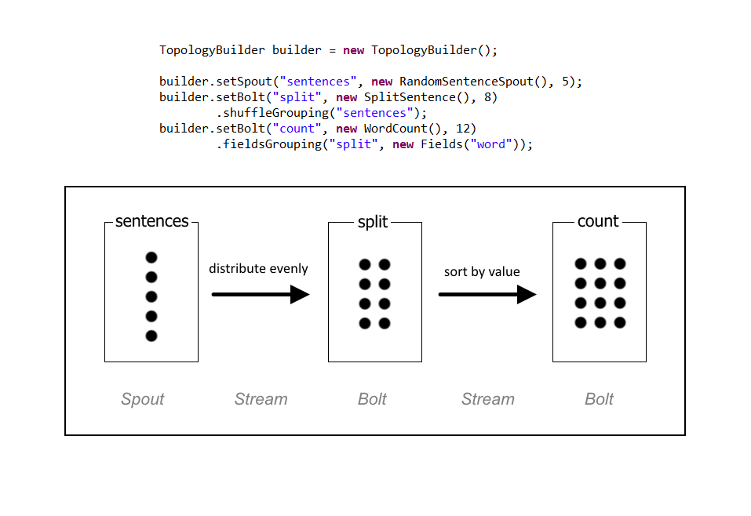
Example – Count Words
HS 2015
Current Trends in Distributed Systems – Apache Storm

Slide 20
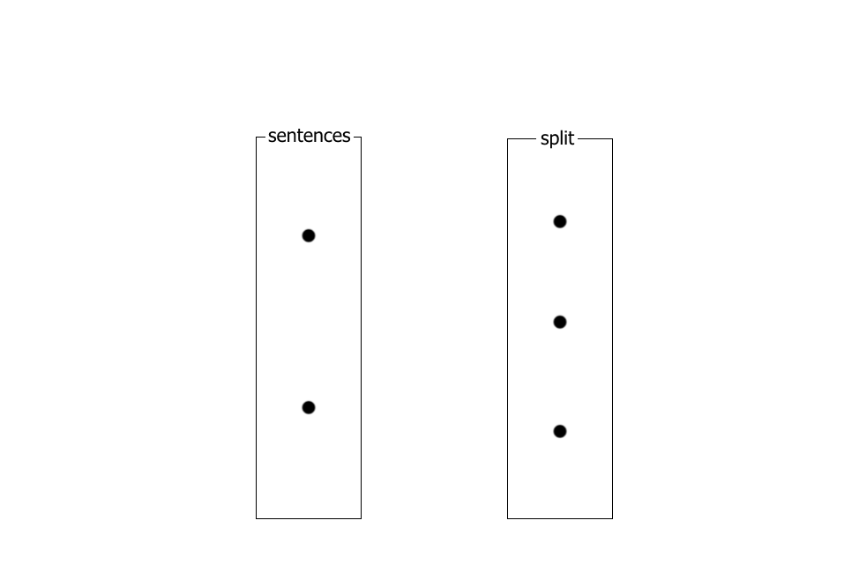
Example – Count Words
The dead are likely dull fellows, full of tedious complaints.
HS 2015
Current Trends in Distributed Systems – Apache Storm

Slide 21
Example – Count Words
The dead are likely dull fellows, full of tedious complaints.
Dead men should keep quiet, is what I say.
HS 2015
Current Trends in Distributed Systems – Apache Storm

Slide 22
Example – Count Words
The dead are likely dull fellows, full of tedious complaints.
No one wants to hear a dead man's yabber.
Dead men should keep quiet, is what I say.
HS 2015
Current Trends in Distributed Systems – Apache Storm

Slide 23
Example – Count Words
The dead are likely dull fellows, full of tedious complaints.
Dead men should keep quiet, is what I say.
No one wants to hear a dead man's yabber.
HS 2015
Current Trends in Distributed Systems – Apache Storm

Slide 24
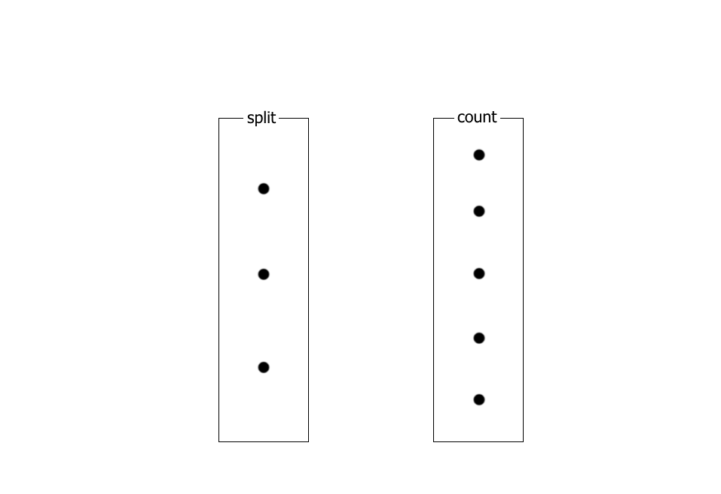
Example – Count Words
the, dead, are, likely, dull, fellows, full, of, tedious, complaints
dead, men, should, keep, quiet, is, what, i, say
no, one, wants, to, hear, a, dead, man, yabber
HS 2015
Current Trends in Distributed Systems – Apache Storm

Slide 25
Example – Count Words
The, are, keep, fellows, of, complaints
dead, dead, to, is, dead, say
no, should, dull, a, i, yabber
men, wants, quiet, full, man
one, likely, hear, what, tedious
HS 2015
Current Trends in Distributed Systems – Apache Storm

Slide 26
Example – Count Words
the | 1
are | 1
keep | 1
fellows | 1
of | 1
complaints | 1
men | 1
wants | 1
quiet | 1
full | 1
man | 1
no | 1
should | 1
dull | 1
a | 1
i | 1
yabber | 1
one | 1
likely | 1
hear | 1
what | 1
tedious | 1
dead | 3
to | 1
is | 1
say | 1
HS 2015
Current Trends in Distributed Systems – Apache Storm

Slide 27
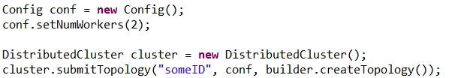
Topologies
HS 2015
Current Trends in Distributed Systems – Apache Storm

Slide 28
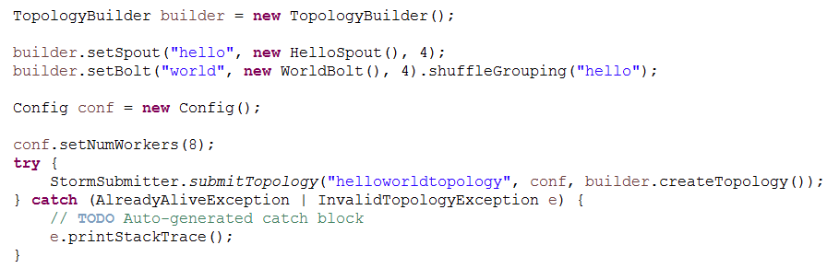
Simple Topology
HS 2015
Current Trends in Distributed Systems – Apache Storm

Slide 29
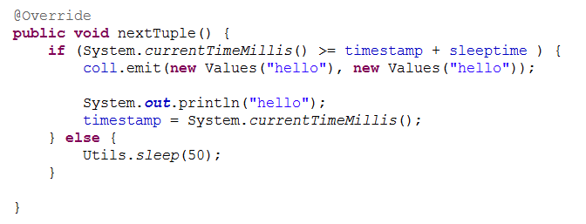
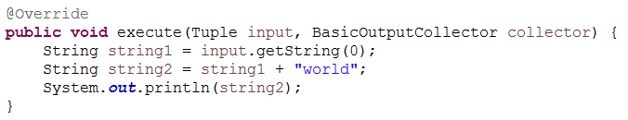
Simple Topology
Spout:
Bolt:
HS 2015
Current Trends in Distributed Systems – Apache Storm

Slide 30
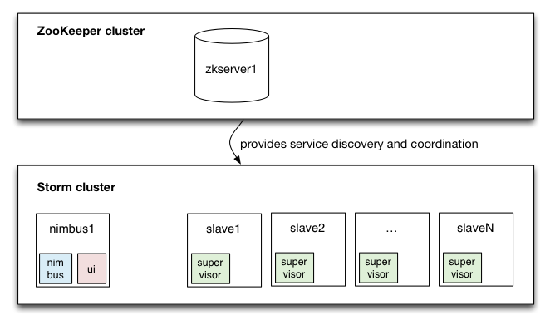
Basics of storm cluster
HS 2015
Current Trends in Distributed Systems – Apache Storm

Slide 31
Problem
First we wanted to use it for our project, but...
Can't assign Bolts/Spouts to specific devices
  Client gets registered at Nimbus without specifications
  >Every Client has to be able to do every job
HS 2015
Current Trends in Distributed Systems – Apache Storm

Slide 32

Solution
Storm Cluster
S1
S2
Server
S3
HS 2015
Current Trends in Distributed Systems – Apache Storm

Slide 33
Conclusion
Huge overhead and setup time
Mostly used in cloud computing
  Lib: https://github.com/nathanmarz/storm-deploy
Probably shouldn't use in your project (if you use sensors)
HS 2015
Current Trends in Distributed Systems – Apache Storm

Slide 34
HS 2015
Current Trends in Distributed Systems
Apache Storm
Group:
Patrick Zumsteg
Simon Wallny
Philipp Oldenburg

